Slide 1
An Introduction to Reinforcement Learning
Solving the Cart Pole Problem

Slide 2
What is Reinforcement Learning?

Slide 3
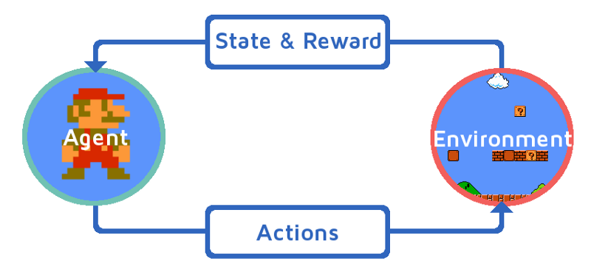

Slide 4
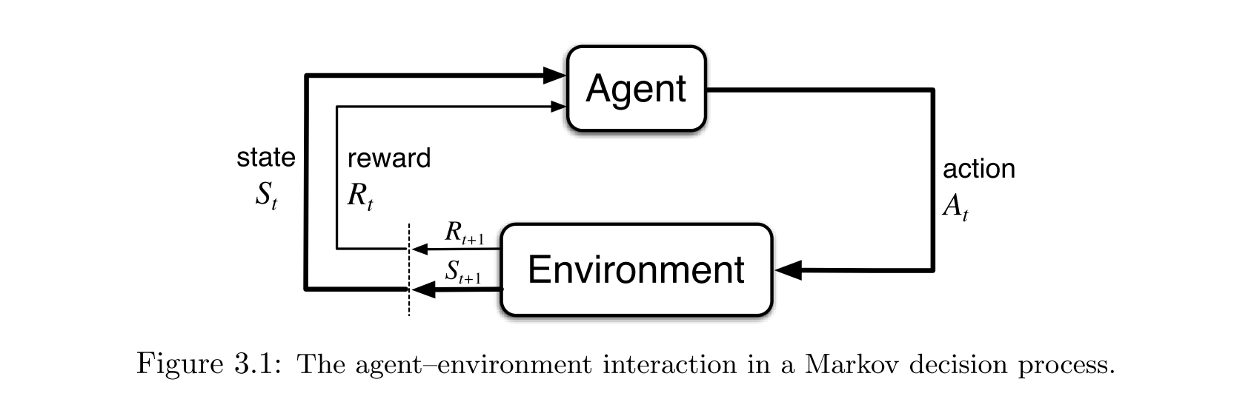
Markov Decision Process

Slide 5
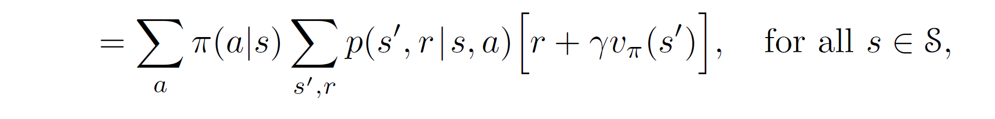
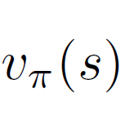
The Bellman Equation

Slide 6
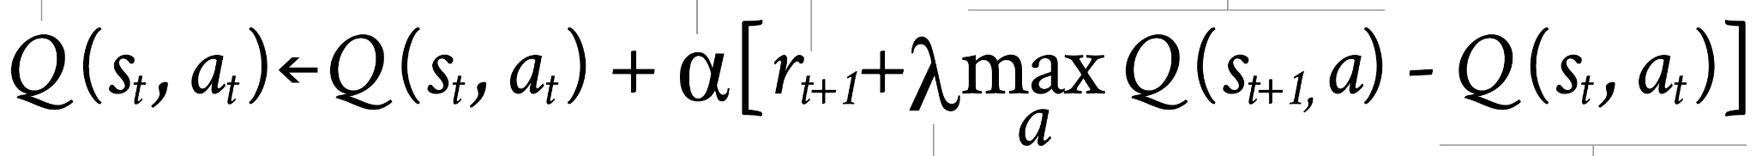
Q-Learning
Q-table
Set of state/action pairs
Q-values
Iterate and update

Slide 7
Cart Pole Problem
A pole is attached by an un-actuated joint to a cart, which moves along a frictionless track. The system is controlled by applying a force of +1 or -1 to the cart. The pendulum starts upright, and the goal is to prevent it from falling over. A reward of +1 is provided for every timestep that the pole remains upright. The episode ends when the pole is more than 15 degrees from vertical, or the cart moves more than 2.4 units from the center.
https://gym.openai.com/envs/CartPole-v1/

Slide 8
The Process The Environment
2 layer dense NN
24 nodes each, ReLU
Linear output
Adam optimizer
Alpha = .001
Epsilon
Decayed from 1.0 to .01 at a rate of .995 per episode
Gamma = .9
Each state consists of:
Cart position
Cart velocity
Pole angle
Pole angular velocity

Slide 9
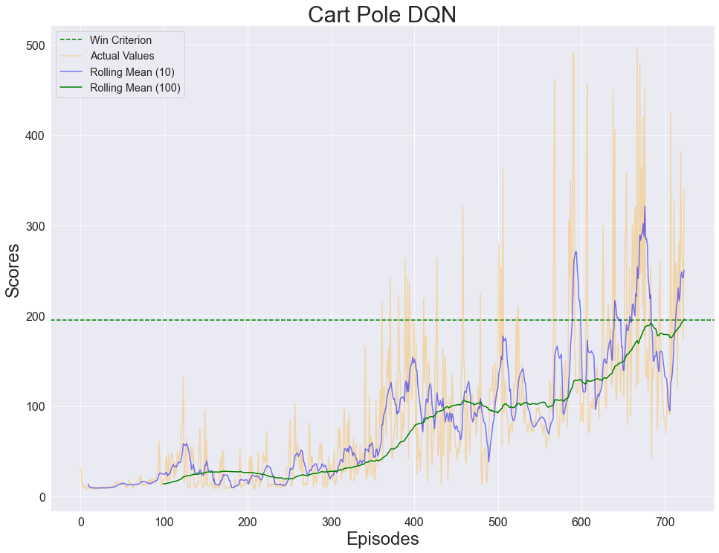

Slide 10
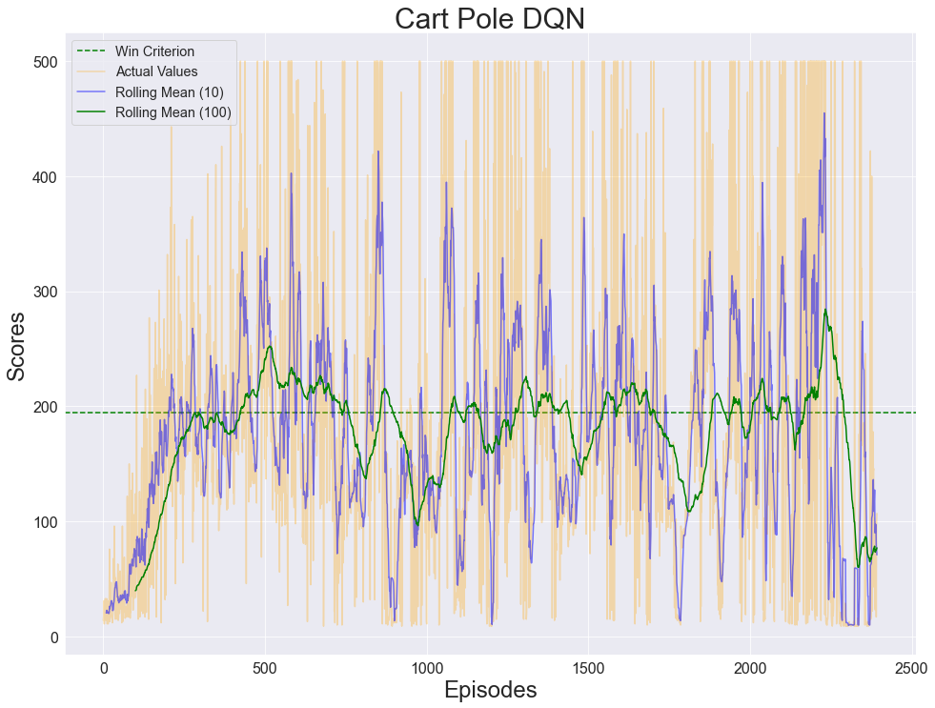

Slide 11
Before
After

Slide 12
Applications
Fanuc Robotics
Tesla and other EV companies
Google data center cooling
Stock trading
Supply chain logistics

Slide 13
References
Reinforcement Learning: An Introduction by Sutton and Barto
Introduction to RL by Greg Surma
Wikipedia:
Reinforcement Learning
Markov Decision Process
Randomant.com on Q-Learning

